Slide 1
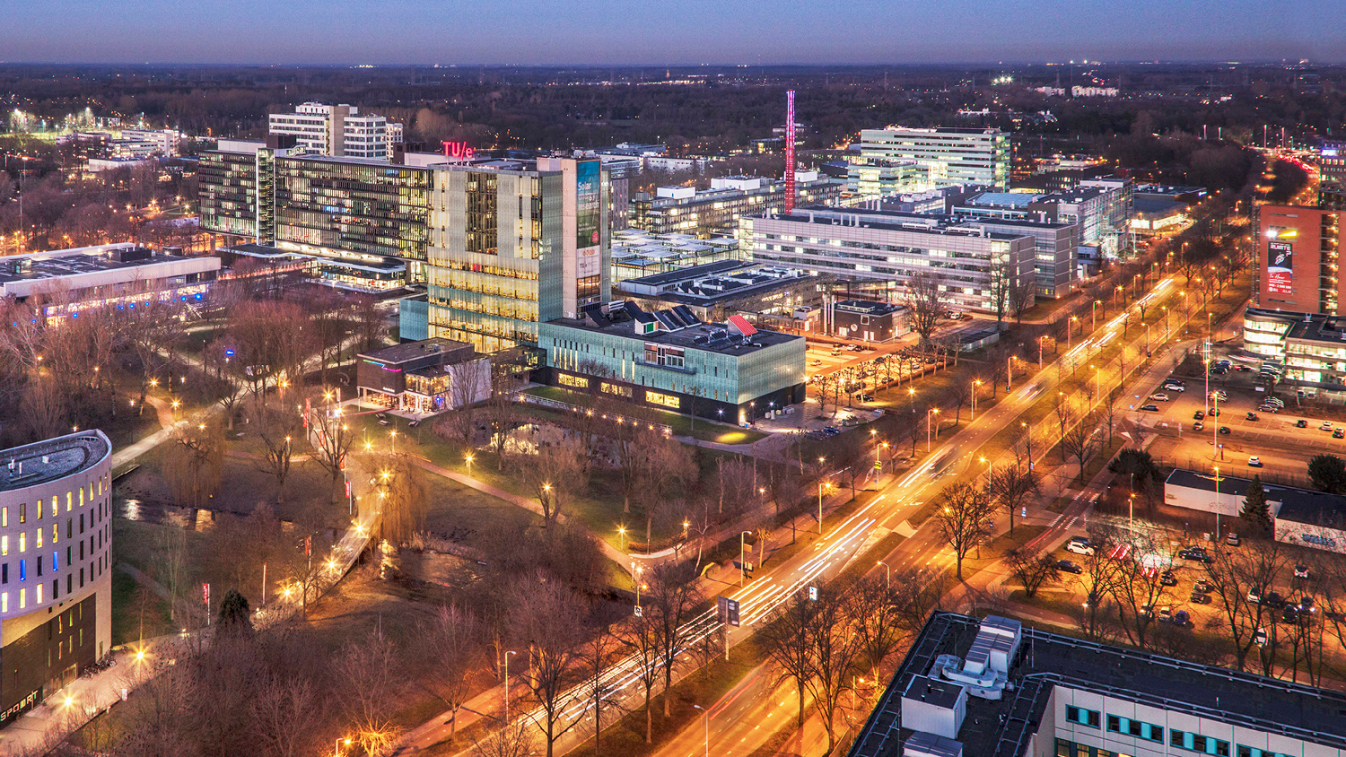
DBL: EMBEDDED SYSTEMS
Interim presentation
Group 25: Serkan Efe Durusu, Ismail Elmasry, Can Ismar, Marios Papalouka, Metehan Topac, Celine Zanders

Slide 2
Contents
Intended function of robot
Design decisions
Ideas for the mechanics
Outline of high-level software structure
Preliminary simulations
Preliminary results
Problems in progress
Questions / remarks ?

Slide 3
Intended function of robot
Sort disks
Pick disk from belt
Create melody based on disk pattern

Slide 4
Design decisions
Push
Grab
2 servos
Optics
melody

Slide 5
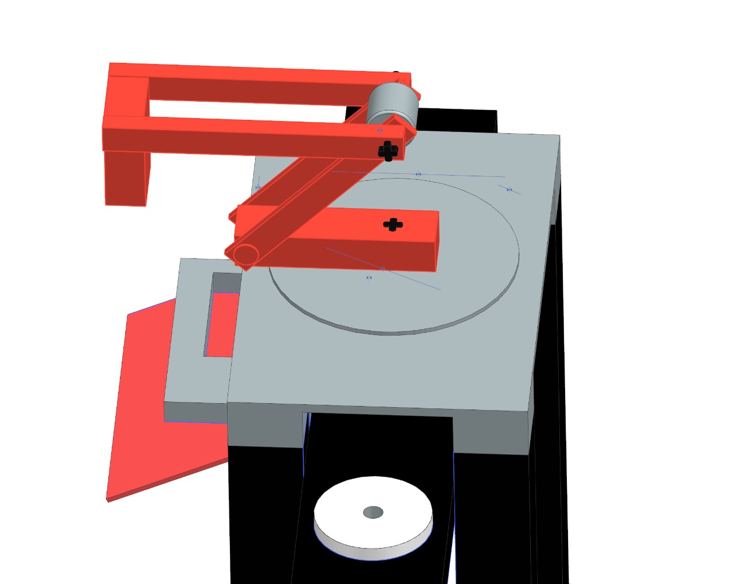
Ideas for the mechanics
Pusher
2 servos
Grabber

Slide 6
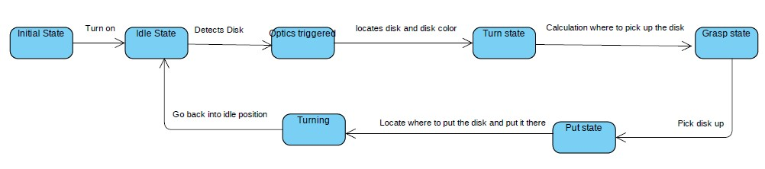
Outline of high-level software structure

Slide 7
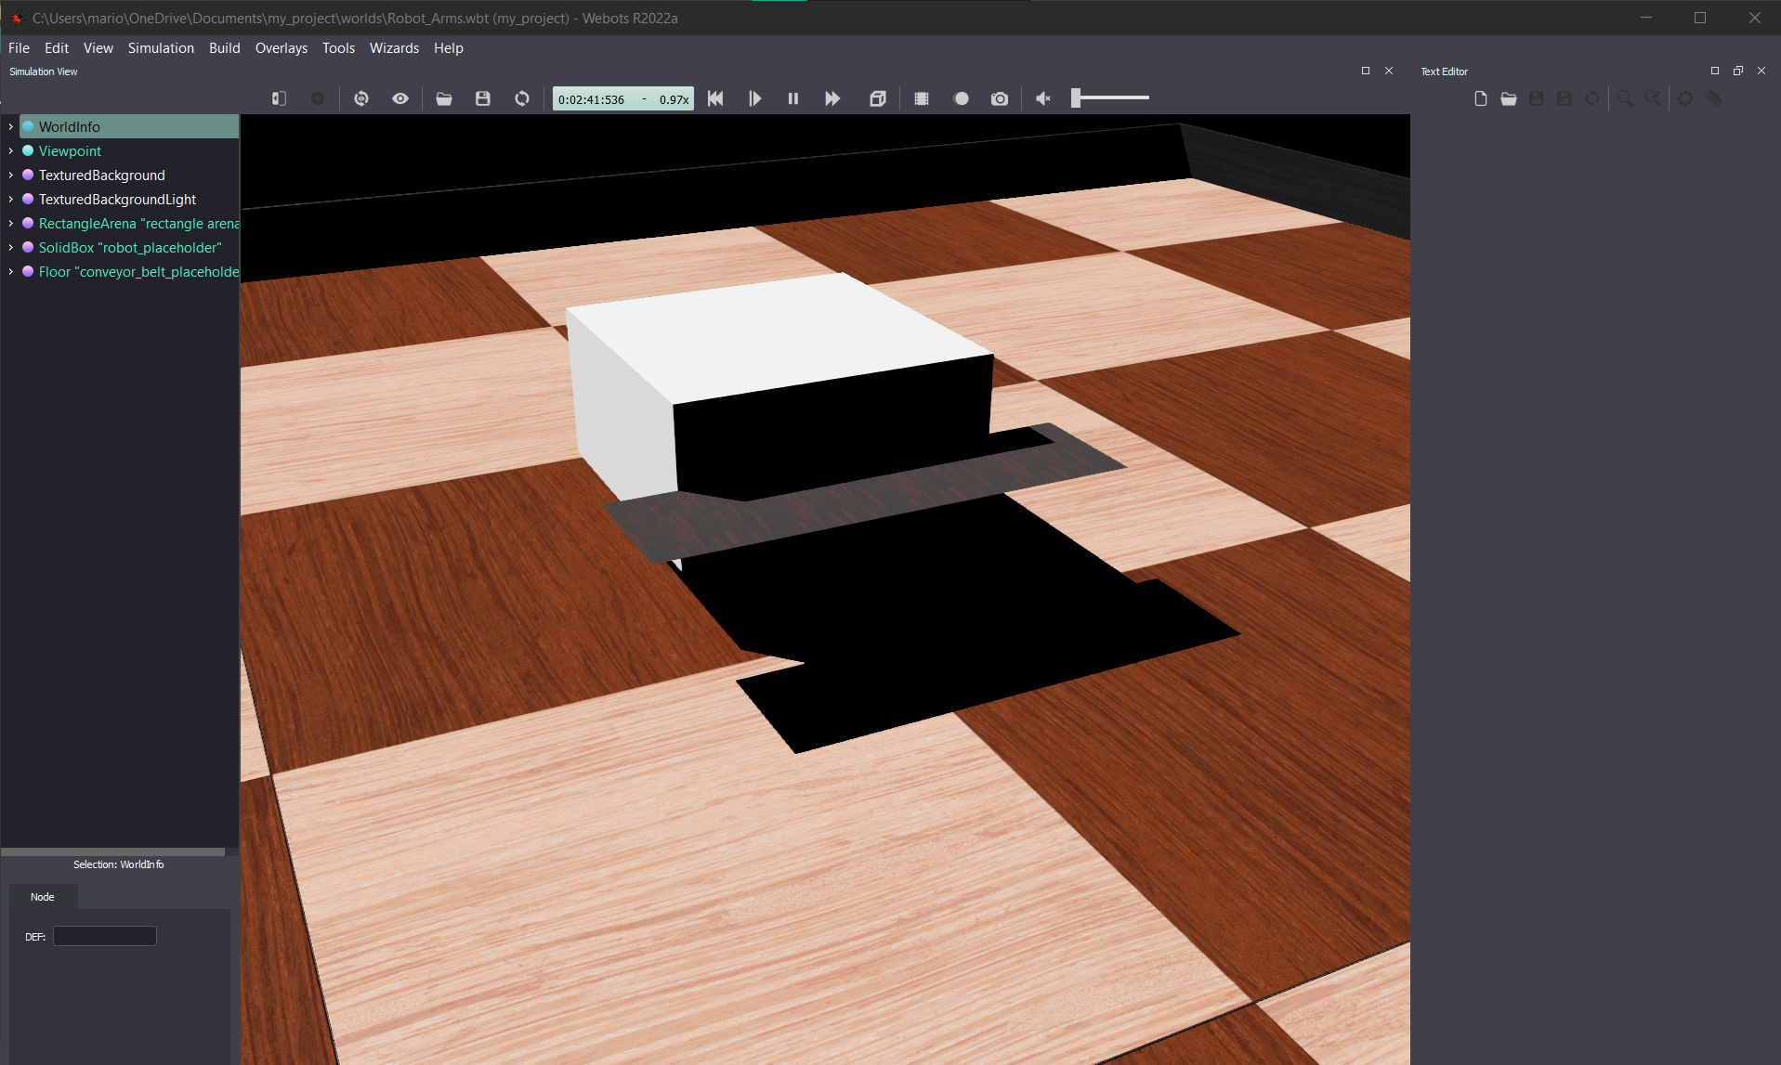
Preliminary simulation/results

Slide 8
Problems in progress
During meetings not always everyone on campus
No further problems

Slide 9
Questions/ Remarks?

